Slide 1
研究项目范例 Saliva Biomarker of Human Lung Cancer
Fengfeng Zhou
Email: FengfengZhou@gmail.com
HILab, SIAT
Web: http://healthinformaticslab.org/ffzhou/

Slide 2
问题模型及数据集

Slide 3
问题模型及数据集
Saliva Biomarker of Human Lung Cancer
Development of Transcriptomic Biomarker Signature in Human Saliva to Detect Lung Cancer
A binary classification problem
Affymetrix HG U133 Plus 2.0 Array (Affymetrix, Santa Clara, CA) was used to profile transcriptomes and discover altered gene expression in saliva supernatant. Salivary transcriptomic biomarker discovery was performed on 10 lung cancer patients and 10 matched controls.
Seven messenger RNA biomarkers were discovered and pre-validated
Platform: GPL570 [HG-U133_Plus_2] Affymetrix Human Genome U133 Plus 2.0 Array
http://www.ncbi.nlm.nih.gov/geo/query/acc.cgi?acc=GSE32175

Slide 4
问题模型及数据集
Saliva Biomarker of Human Lung Cancer
Lung cancer is the leading cause of cancer death for both men and women worldwide. Since most of the symptoms found for lung cancer are nonspecific, diagnosis is mostly done at late and progressed stage with the consecutive poor therapy outcome. Effective early detection techniques are sorely needed. The emerging field of salivary diagnostics could provide scientifically credible, easy-to-use, non-invasive and cost-effective detection methods. Recent advances have allowed us to develop discriminatory salivary biomarkers for a variety of diseases from oral to systematic diseases. In this study, salivary transcriptomes of lung cancer patients were profiled and led to the discovery and pre-validation of seven highly discriminatory transcriptomic salivary biomarkers (BRAF, CCNI, EGRF, FGF19, FRS2, GREB1, and LZTS1). The logistic regression model combining five of the mRNA biomarkers (CCNI, EGFR, FGF19, FRS2, and GREB1) could differentiate lung cancer patients from normal control subjects, yielding AUC value of 0.925 with 93.75 % sensitivity and 82.81 % specificity in the pre-validation sample set. These salivary mRNA biomarkers possess the discriminatory power for the detection of lung cancer. This report provides the proof of concept of salivary biomarkers for the non-invasive detection of the systematic disease. These results poised the salivary biomarkers for the initiation of a multi-center validation in a definitive clinical context.
Zhang L., et al. Development of transcriptomic biomarker signature in human saliva to detect lung cancer. Cell Mol Life Sci. 2012 Oct; 69(19): 3341-50.

Slide 5
问题模型及数据集
Saliva Biomarker of Human Lung Cancer
#Sample | Description | #Sample | Description
GSM797551 | Healthy control saliva-lc1 | GSM797561 | Lung cancer saliva-1
GSM797552 | Healthy control saliva-lc2 | GSM797562 | Lung cancer saliva-2
GSM797553 | Healthy control saliva-lc3 | GSM797563 | Lung cancer saliva-3
GSM797554 | Healthy control saliva-lc4 | GSM797564 | Lung cancer saliva-4
GSM797555 | Healthy control saliva-lc5 | GSM797565 | Lung cancer saliva-5
GSM797556 | Healthy control saliva-lc6 | GSM797566 | Lung cancer saliva-6
GSM797557 | Healthy control saliva-lc7 | GSM797567 | Lung cancer saliva-7
GSM797558 | Healthy control saliva-lc8 | GSM797568 | Lung cancer saliva-8
GSM797559 | Healthy control saliva-lc9 | GSM797569 | Lung cancer saliva-9
GSM797560 | Healthy control saliva-lc10 | GSM797570 | Lung cancer saliva-10
http://www.ncbi.nlm.nih.gov/geo/query/acc.cgi?acc=GSE32175

Slide 6
数据探索

Slide 7
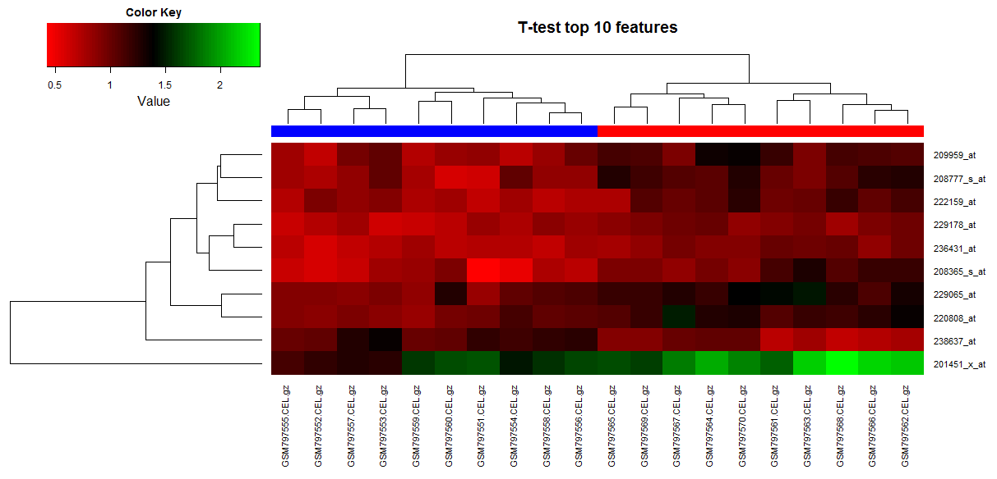
数据探索
Saliva Biomarker of Human Lung Cancer
Top-10 features ranked by T-test. The heatmap shows that the two classes can be separated by the 10 features.

Slide 8
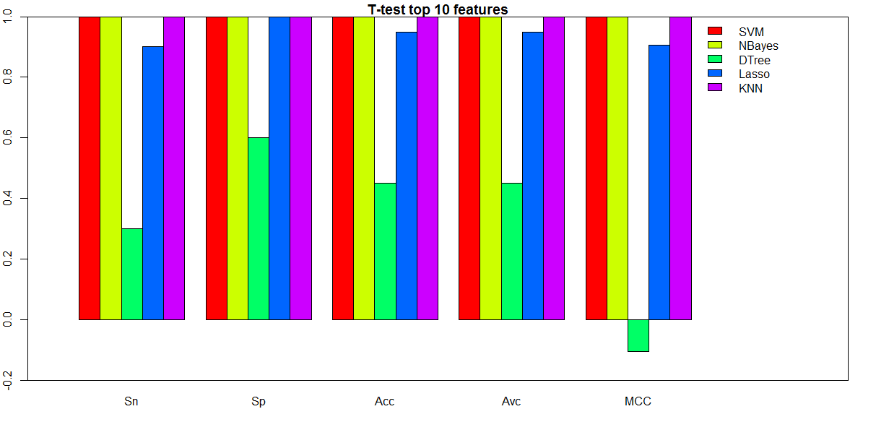
数据探索
Saliva Biomarker of Human Lung Cancer
Top-10 features ranked by T-test are used to train the classifiers with very high accuracies.

Slide 9
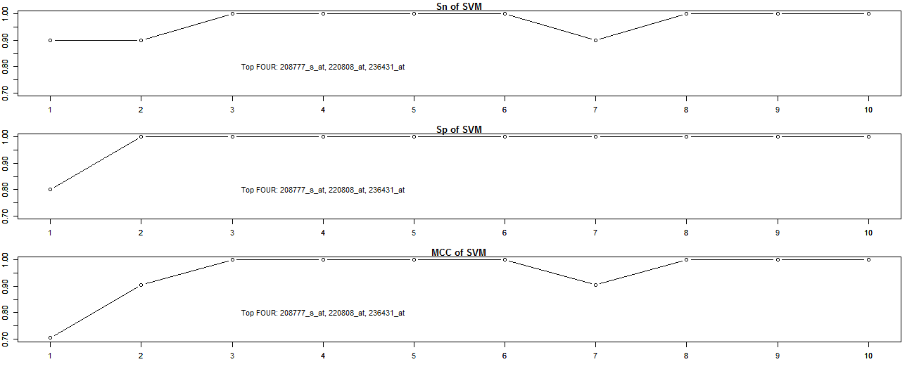
数据探索
Saliva Biomarker of Human Lung Cancer
Our question is whether fewer features may generate the classification models with similar performances for SVM and NBayes?

Slide 10
疾病标志物检测

Slide 11
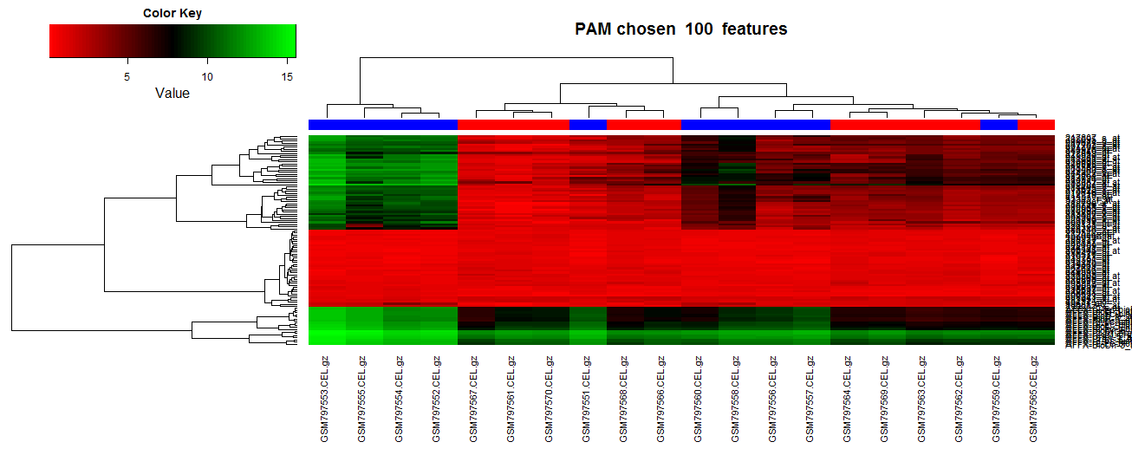
数据探索
Saliva Biomarker of Human Lung Cancer
3 fold cross validation. Features are selected by PAM.

Slide 12
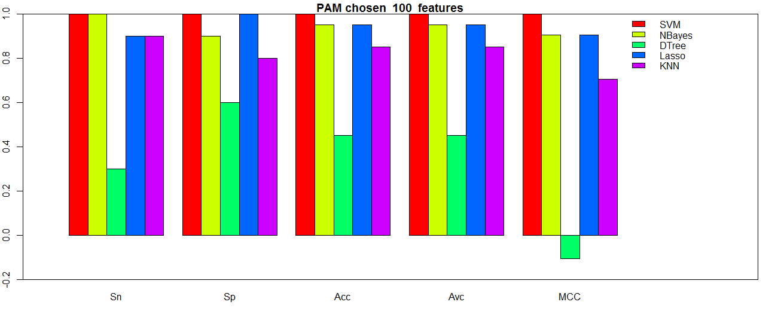
数据探索
Saliva Biomarker of Human Lung Cancer
3 fold cross validation. Features are selected by PAM.

Slide 13
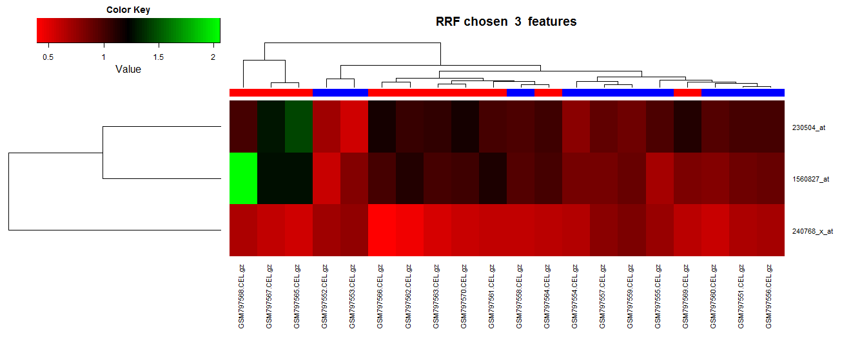
数据探索
Saliva Biomarker of Human Lung Cancer
3 fold cross validation. Features are selected by RRF.

Slide 14
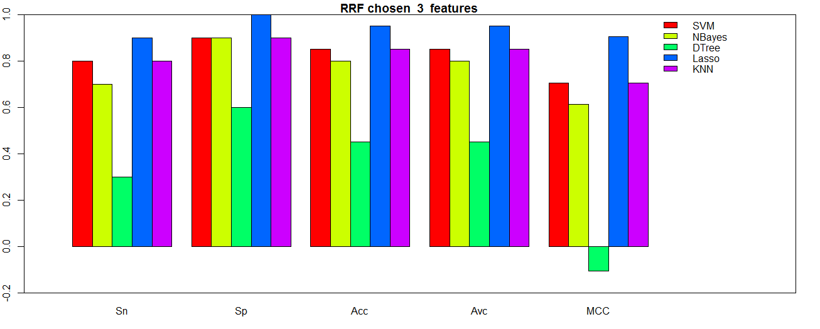
数据探索
Saliva Biomarker of Human Lung Cancer
3 fold cross validation. Features are selected by RRF.

Slide 15
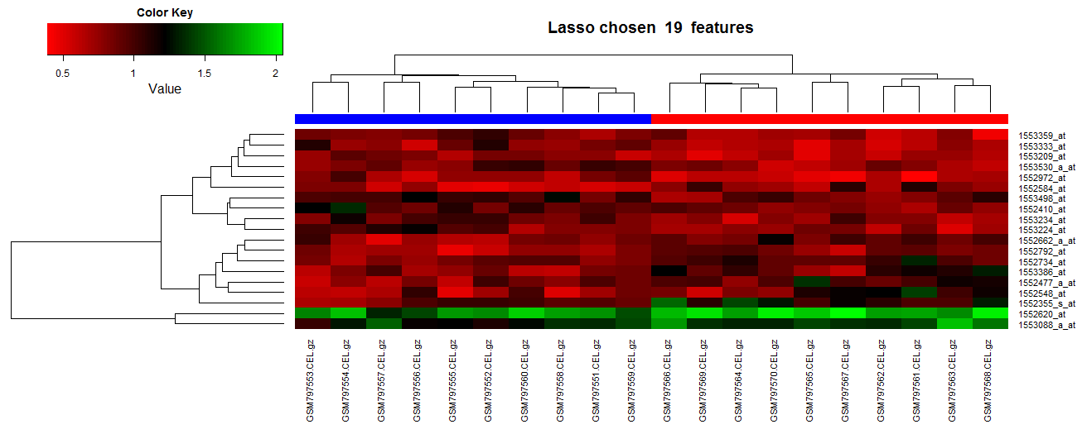
数据探索
Saliva Biomarker of Human Lung Cancer
3 fold cross validation. Features are selected by Lasso.

Slide 16
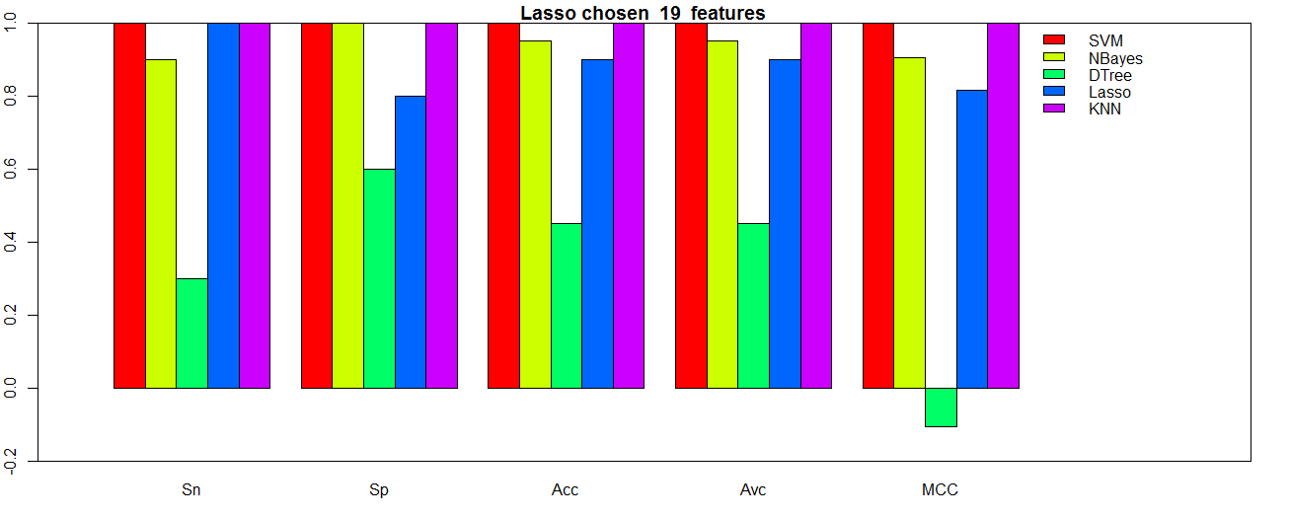
数据探索
Saliva Biomarker of Human Lung Cancer
3 fold cross validation. Features are selected by Lasso.

Slide 17
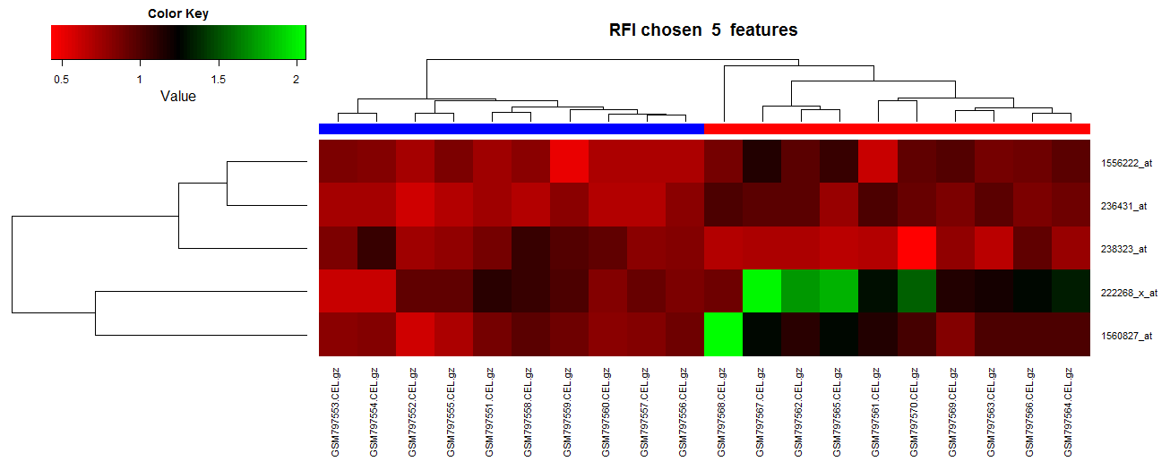
数据探索
Saliva Biomarker of Human Lung Cancer
3 fold cross validation. Features are selected by RFI.

Slide 18
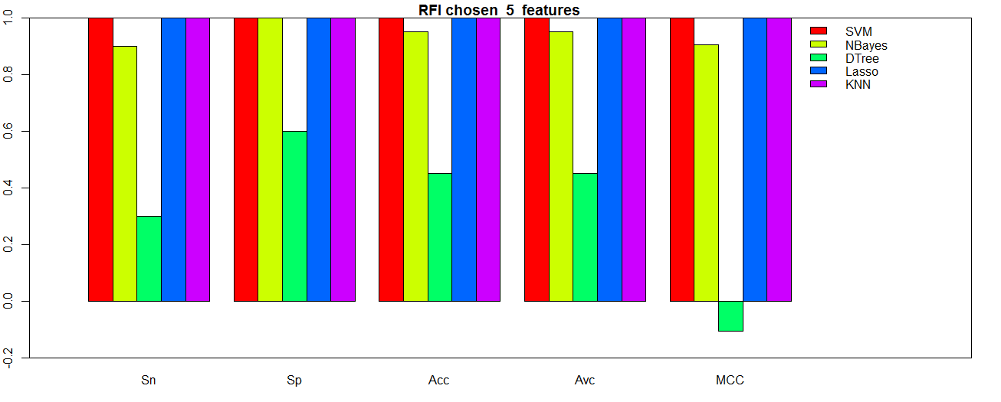
数据探索
Saliva Biomarker of Human Lung Cancer
3 fold cross validation. Features are selected by RFI.

Slide 19
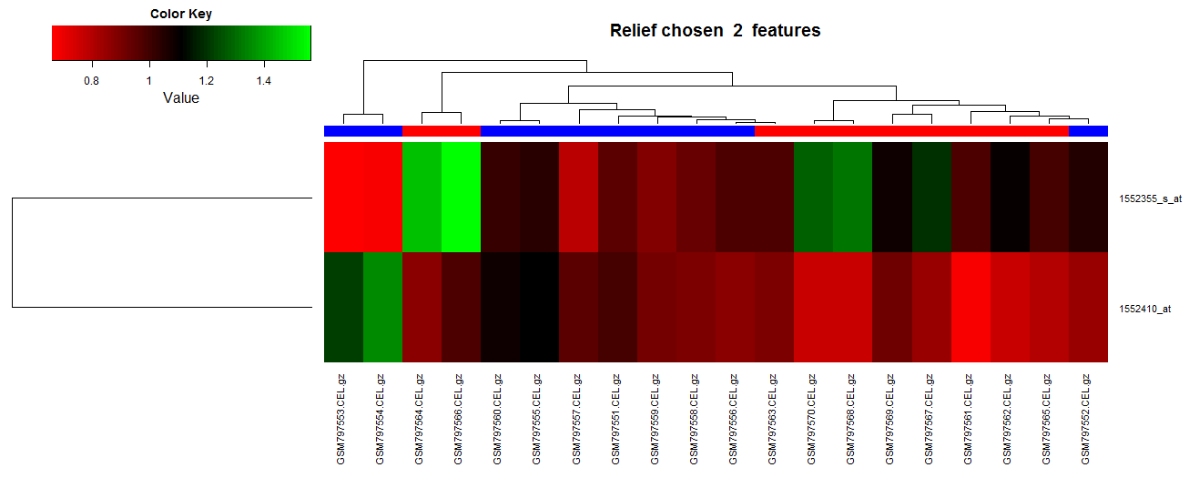
数据探索
Saliva Biomarker of Human Lung Cancer
3 fold cross validation. Features are selected by Relief.

Slide 20
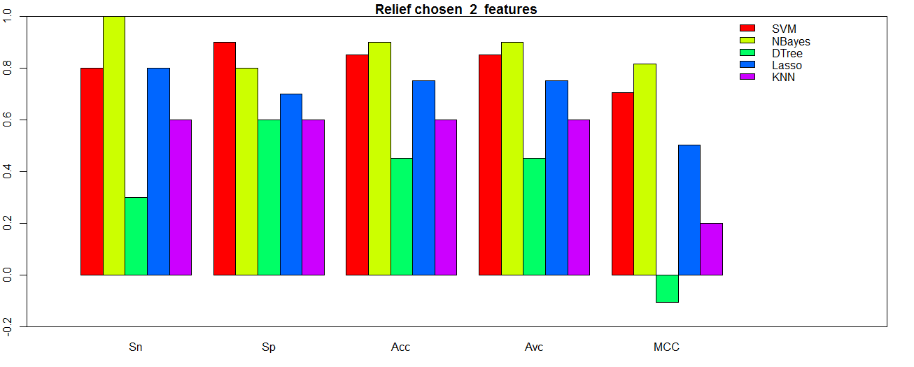
数据探索
Saliva Biomarker of Human Lung Cancer
3 fold cross validation. Features are selected by Relief.

Slide 21
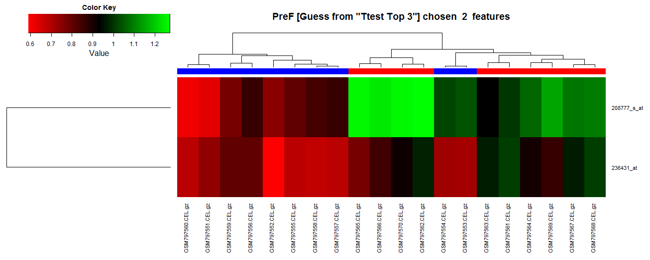
数据探索
Saliva Biomarker of Human Lung Cancer
3 fold cross validation. Exhaustive search for the best feature pairs from the top 3 features from T-test. (Rank-3 + Rank-1)

Slide 22
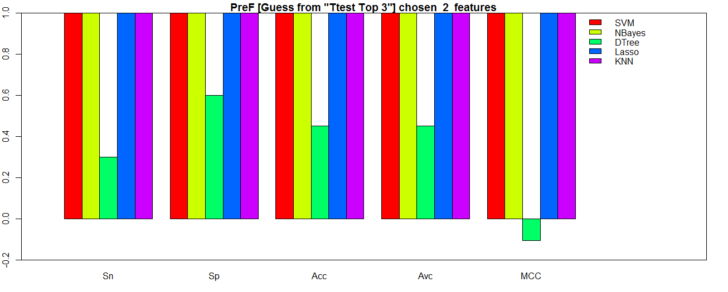
数据探索
Saliva Biomarker of Human Lung Cancer
3 fold cross validation. Exhaustive search for the best feature pairs from the top 3 features from T-test.

Slide 23
生物功能分析

Slide 24
数据探索
Saliva Biomarker of Human Lung Cancer
236431_at | U2-associated SR140 protein
GOTERM_BP_FAT | RNA processing,
GOTERM_MF_FAT | nucleotide binding, RNA binding,
INTERPRO | SWAP/Surp, RNA recognition motif, RNP-1, Regulation of nuclear pre-mRNA protein, Nucleotide-binding, alpha-beta plait,
KEGG_PATHWAY | Spliceosome,
SMART | RRM, RPR, SWAP,
SP_PIR_KEYWORDS | acetylation, alternative splicing, coiled coil, complete proteome, phosphoprotein, rna-binding,
UP_SEQ_FEATURE | chain:U2-associated protein SR140, compositionally biased region:Arg/Ser-rich, compositionally biased region:Asp-rich, compositionally biased region:Glu-rich, compositionally biased region:Pro-rich, domain:CID, domain:RRM, modified residue, repeat:SURP motif, splice variant,

Slide 25
数据探索
Saliva Biomarker of Human Lung Cancer
208777_s_at | proteasome (prosome, macropain) 26S subunit, non-ATPase, 11
COG_ONTOLOGY | Posttranslational modification, protein turnover, chaperones,
GOTERM_BP_FAT | mitotic cell cycle, proteolysis, ubiquitin-dependent protein catabolic process, cell cycle, macromolecule catabolic process, proteasomal protein catabolic process, positive regulation of macromolecule metabolic process, negative regulation of macromolecule metabolic process, modification-dependent protein catabolic process, cell cycle process,protein catabolic process, anaphase-promoting complex-dependent proteasomal ubiquitin-dependent protein catabolic process, regulation of protein ubiquitination, negative regulation of protein ubiquitination, positive regulation of protein ubiquitination, regulation of protein modification process, etc
GOTERM_CC_FAT | proteasome complex, cytosol,
INTERPRO | Proteasome component region PCI, Winged helix repressor DNA-binding, PCI/PINT associated module,
KEGG_PATHWAY | Proteasome,
PIR_SUPERFAMILY | PIRSF006840:26S proteasome non-ATPase regulatory subunit 11,
SMART | PINT, PAM,
SP_PIR_KEYWORDS | acetylation, complete proteome, direct protein sequencing, phosphoprotein, proteasome, protein degradation,
UP_SEQ_FEATURE | chain:26S proteasome non-ATPase regulatory subunit 11, domain:PCI, modified residue, sequence conflict,

Slide 26
分类性能比较

Slide 27
数据探索
Saliva Biomarker of Human Lung Cancer
Cell Mol Life Sci. 2012 Oct;69(19):3341-50. doi: 10.1007/s00018-012-1027-0. Epub 2012 Jun 12.
Development of transcriptomic biomarker signature in human saliva to detect lung cancer.
Zhang L¹, Xiao H, Zhou H, Santiago S, Lee JM, Garon EB, Yang J, Brinkmann O, Yan X, Akin D, Chia D, Elashoff D, Park NH, Wong DT.
http://www.ncbi.nlm.nih.gov/pubmed/22689099

Slide 28
数据探索
Saliva Biomarker of Human Lung Cancer
Abstract
Lung cancer is the leading cause of cancer death for both men and women worldwide. Since most of the symptoms found for lung cancer are nonspecific, diagnosis is mostly done at late and progressed stage with the consecutive poor therapy outcome. Effective early detection techniques are sorely needed. The emerging field of salivary diagnostics could provide scientifically credible, easy-to-use, non-invasive and cost-effective detection methods. Recent advances have allowed us to develop discriminatory salivary biomarkers for a variety of diseases from oral to systematic diseases. In this study, salivary transcriptomes of lung cancer patients were profiled and led to the discovery and pre-validation of seven highly discriminatory transcriptomic salivary biomarkers (BRAF, CCNI, EGRF, FGF19, FRS2, GREB1, and LZTS1). The logistic regression model combining five of the mRNA biomarkers (CCNI, EGFR, FGF19, FRS2, and GREB1) could differentiate lung cancer patients from normal control subjects, yielding AUC value of 0.925 with 93.75 % sensitivity and 82.81 % specificity in the pre-validation sample set. These salivary mRNA biomarkers possess the discriminatory power for the detection of lung cancer. This report provides the proof of concept of salivary biomarkers for the non-invasive detection of the systematic disease. These results poised the salivary biomarkers for the initiation of a multi-center validation in a definitive clinical context.

Slide 29
数据探索
Saliva Biomarker of Human Lung Cancer

Slide 30
数据探索
Saliva Biomarker of Human Lung Cancer

Slide 31
Thanks! Any questions?

